Slide 1
Deep Learning Training
Lecture 6: Natural Language Processing, Word Embedding, RNN

Slide 2
Content
NLP
Deep Learning in NLP
Word Embedding
Word2vec, GloVe, fastText
RNN

Slide 3
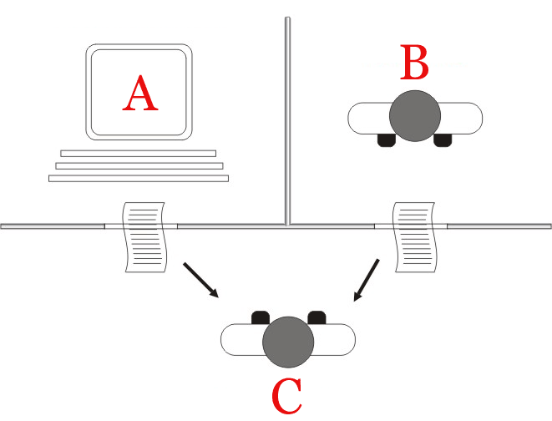
Natural Language Processing
Goal: for computers to process or “understand” natural language in order to perform tasks that are useful
Figure: Standard interpretation" of the Turing test, in which player C, the interrogator, is given the task of trying to determine which player – A or B – is a computer and which is a human

Slide 4
NLP Applications
Information Retrieval
Spell Checking
Document classification, sentiment analysis
Machine Translation
Question Answering
Search
Speech Recognition
Chatbots

Slide 5
Why NLP is hard
Discrete signaling system unlike computer vision
Different modes of communication like speech, gesture, text
Large vocabulary creates sparsity
171,476 common words in Oxford English Dictionary
Ambiguity and nuances of language. Some examples
Enraged cow injures farmer with axe
Boy paralyzed after tumor fights back to gain black belt
Time flies like an arrow; fruit flies like a banana
We saw her duck

Slide 6
Deep Learning in NLP
Learn distributed representations
Learned features instead of hand crafted features
Learning can be done unsupervised
Does not require domain specific knowledge for different tasks or languages
End to end learning

Slide 7
Need for Distributed Word Representations
Discrete representations result in very sparse vector
Traditionally words are represented as one-hot vector
bus = [… 0 0 0 0 1 0 0 …]
train = [… 0 0 1 0 0 0 0 …]
Vector dimension => Number of words
No notion of similarity between words
Vectors are orthogonal

Slide 8
Learning Word Representations from Context
Basic Idea: A word’s meaning is given by the words that appear close to it
“You shall know a word by the company it keeps” (J. R. Firth 1957: 11)
When a word appears in a text, its context is the set of words that appear nearby within a fixed sized window.
Build representation for a word using its context
But baseball, football and basketball have nothing on hockey.
The men's basketball final will be on Sunday.
The sports center has a basketball court and two squash courts.

Slide 9
Word Vectors
Build a dense vector for each word
Words that appear in similar context will have similar vector
Usually 100~1000 dimensional vectors are used
Before: basketball = [… 0 0 1 0 0 …]
vector dimension: order of million
Now: basketball = [… 0.298 -0.456 -0.720 0.191 0.873 …]
vector dimension: ~1000

Slide 10
word2vec
Simple 2-layer neural network
2 types
Continuous bag of words (CBOW)
Skip-gram
CBOW: Predict center word from context word
Faster to train
Slightly better accuracy for frequent words
Skip-gram: Predict context word from center word
Requires less training data
Represents well even rare words or phrases

Slide 11
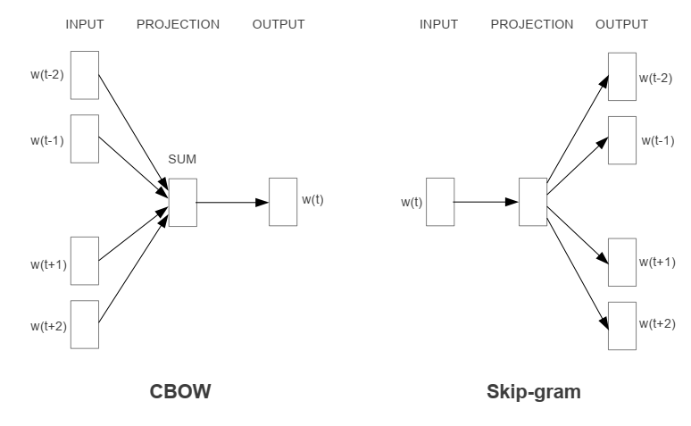
Continuous Bag-of-Words and Skip-gram model

Slide 12
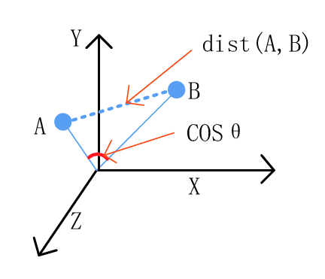
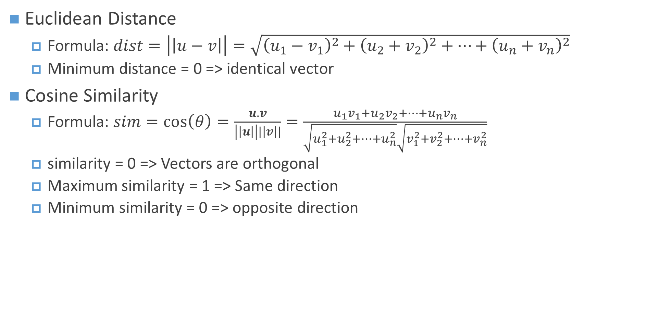
Word Similarity from Word Vector
Euclidean Distance
Formula: $dist=\left|\left|u−v\right|\right|=\sqrt{{\left(u_{1}−v_{1}\right)}^{2}+{\left(u_{2}+v_{2}\right)}^{2}+…+{\left(u_{n}+v_{n}\right)}^{2}}$
Minimum distance = 0 => identical vector
Cosine Similarity
Formula: $sim=\cos\left(θ\right)=\frac{u.v}{\left|\left|u\right|\right||\left|v\right||}=\frac{u_{1}v_{1}+u_{2}v_{2}+…+u_{n}v_{n}}{\sqrt{u_{1}^{2}+u_{2}^{2}+…+u_{n}^{2}}\sqrt{v_{1}^{2}+v_{2}^{2}+…+v_{n}^{2}}}$
similarity = 0 => Vectors are orthogonal
Maximum similarity = 1 => Same direction
Minimum similarity = 0 => opposite direction

Slide 13
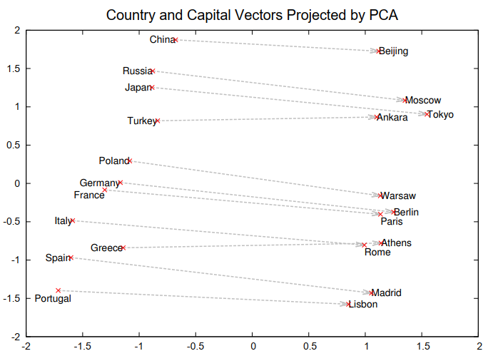
Word Analogy
Figure: 2 dimensional PCA projection of 1000 dimensional vector

Slide 14
Word Analogy
Type of relationship | Word Pair 1 |  | Word Pair 2
Common capital city All capital cities Currency City-in-state Man-Woman | Athens Astana Angola Chicago brother | Greece Kazakhstan kwanza Illinois sister | Oslo Harare Iran Stockton grandson | Norway Zimbabwe rial California granddaughter
Adjective to adverb Opposite Comparative Superlative Present Participle Nationality adjective Past tense Plural nouns Plural verbs | apparent possibly great easy think Switzerland walking mouse work | apparently impossibly greater easiest thinking Swiss walked mice works | rapid ethical tough lucky read Cambodia swimming dollar speak | rapidly unethical tougher luckiest reading Cambodian swam dollars speaks

Slide 15
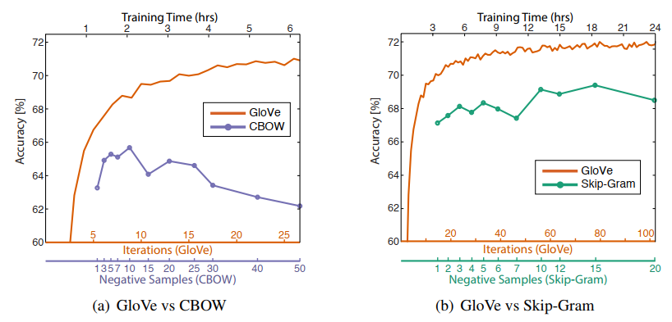
GloVe: Global Vectors for Word Representation
Takes global corpus statistics taken into account as well as local context

Slide 16
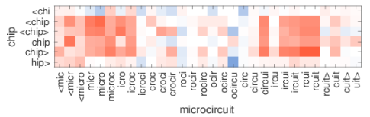
fastText
Uses subword embedding to capture internal structure of words.
Using sequence of characters n-grams (3 to 6) are extracted.
Special characters ‘<‘ and ‘>’ are used to denote prefix and suffix
For word where subwords with length 3
<wh, whe, her, ere, re>, <where>
Results in larger vocabulary
Figure: microcircuit is out of vocabulary, red indicates positive cosine, blue negative cosine

Slide 17
Text Preprocessing
Lowercase conversion
Stop words removal
Stemming
Lemmatization
Tokenization
Japanese tokenization library: MeCab
Uncommon words removal for classification task

Slide 18
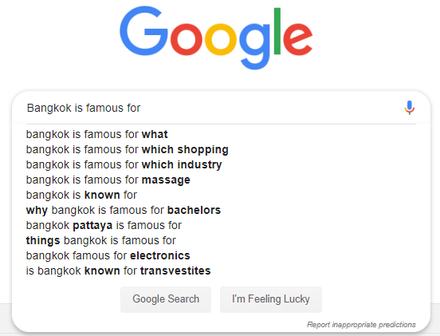
Language Model
Task of predicting what word comes next

Slide 19
N-gram Language Models
An n-gram is a chunk of n consecutive words
The sports center has a basketball court and two squash courts
Unigrams: The, sports, center, has, a basketball, court, and, two, squash, courts
Bigrams: The sports, sports center, center has, has a, a basketball, basketball court…
Trigrams: The sports center, sports center has, center has a, has a basketball, a basketball court…
4-grams: The sports center has, sports center has a…
Collect statistics about different n-grams and use them to predict next word
Problems
Not all combination will be present in training data
Requires exponential storage in n-gram count
Does not always produce coherent result because past words become irrelevant

Slide 20
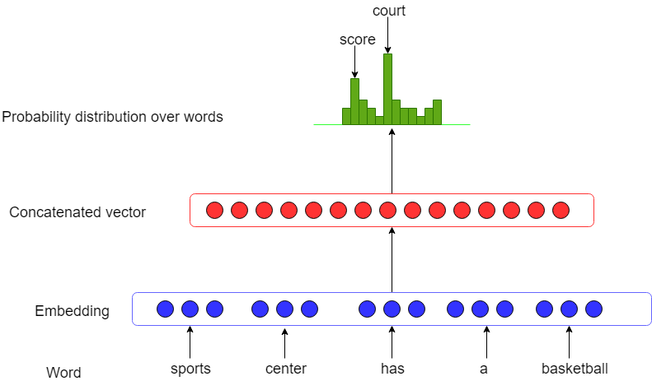
Fixed Window Neural Language Model
Concatenate word embeddings in a window to predict next word
Prevents sparsity issue
Cannot use long term dependency

Slide 21
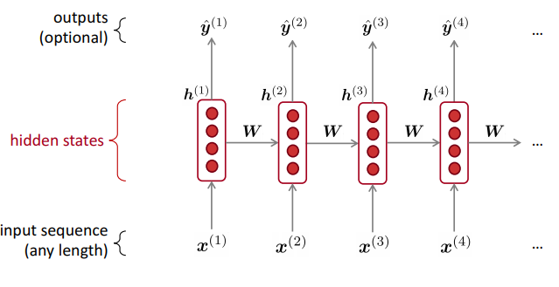
Recurrent Neural Networks(RNN)
Family of neural networks for processing sequential data
Share the same weight across several time steps

Slide 22
RNN
Advantages
Can process any length input
Model size doesn’t increase for longer input
Can use information from many steps back
Learn shared representations
Disadvantages
Slow computation
Difficult to train

Slide 23
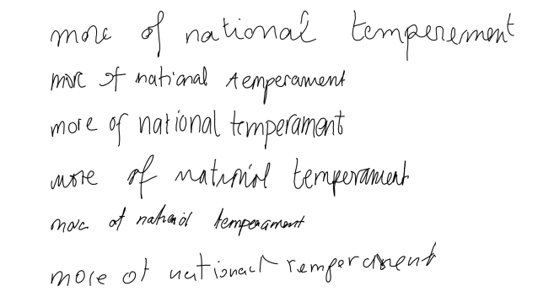
Sequence Generation using RNN
The '''Rebellion''' (''Hyerodent'') is [[literal]], related mildly older than old half sister, the music, and morrow been much more propellent. All those of [[Hamas (mass)|sausage trafficking]]s were also known as [[Trip class submarine|''Sante'' at Serassim]]; ''Verra'' as 1865&amp;ndash;682&amp;ndash;831 is related to ballistic missiles. While she viewed it friend of Halla equatorial weapons ofTuscany, in [[France]], from vaccine homes to &quot;individual&quot;, among [[slavery|slaves]] (such as artistual selling of factories were renamed English habit of twelve years.)
Left: Generated Wikipedia article Right: Real(top) and generated(rest) handwriting using RNN

Slide 24
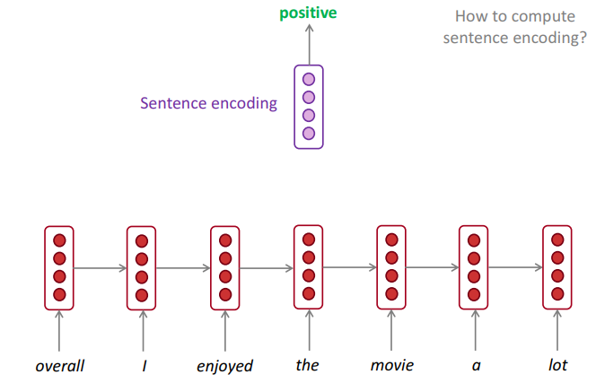
RNN for classification
Generate a sequence vector
Use fully connected and softmax for classification

Slide 25
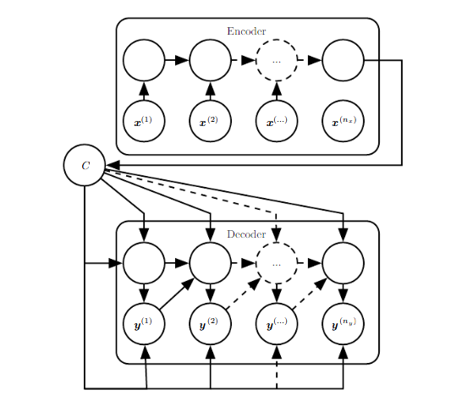
Encoder-Decoder Sequence-to-Sequence Architectures
Generate arbitrary length output from arbitrary length input
2 parts
Encoder: Processed input sequence to generate fixed length context vector
Decoder: Generates output sequence using context vector
Used in
Machine Translation
Question Answering
Speech Recognition

Slide 26
Tasks
Calculate similarity between vectors
Use pretrained word embedding to perform
Word similarity
Word analogy
RNN in PyTorch
Train RNN for simulated sequential data

Slide 27
Thank You

Slide 28
Reference
https://www.deeplearningbook.org/contents/rnn.html
http://web.stanford.edu/class/cs224n/
https://papers.nips.cc/paper/5021-distributed-representations-of-words-and-phrases-and-their-compositionality.pdf
https://fasttext.cc/
https://nlp.stanford.edu/projects/glove/

